Slide 1
Specific Latent Heat

Slide 2
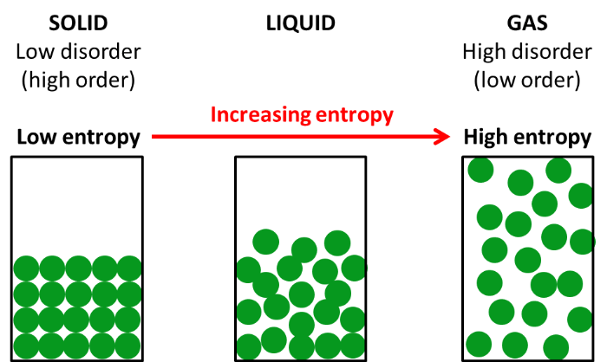
In the Smart Lesson you will learn to:
Define specific latent heat.
Solve problems involving specific latent heat.

Slide 3
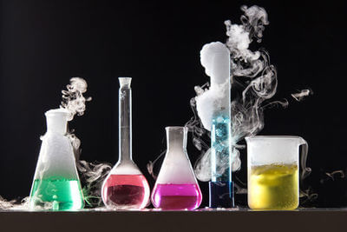
State changes require energy to be added to or removed from a system.
Melting and vaporisation both require an energy input.
Condensation and solidification both require energy to be removed from the system.

Slide 4
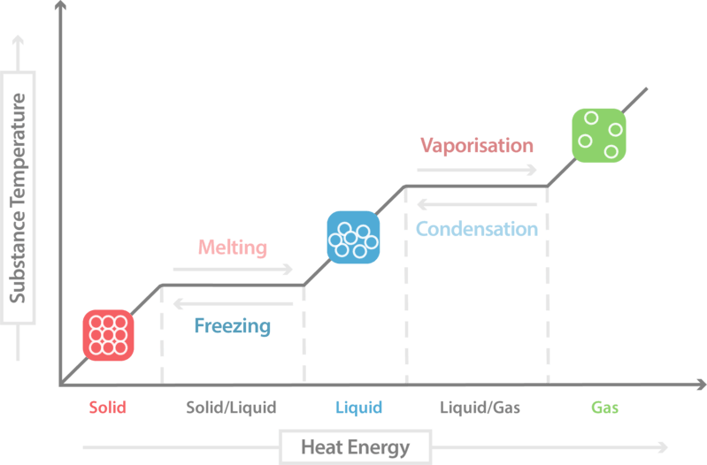
Energy added during a state change is called the latent heat.
The specific latent heat of fusion is the energy needed to change 1 kg of a substance from solid to liquid.
The specific latent heat of vaporisation is the energy needed to change 1 kg of a substance from liquid to gas.

Slide 5

The temperature of a system remains the same during the process of state change.
The energy being added to or removed from the system (latent heat) is being used to break or form intermolecular bonds. The kinetic energy of the particles does not change, so the temperature does not change.

Slide 6
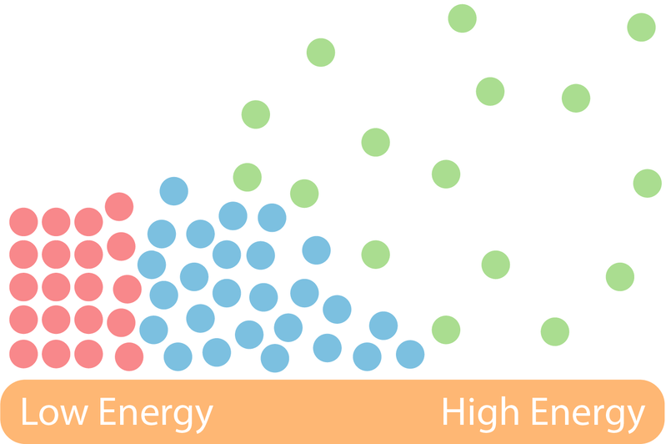
The latent heat does not affect the kinetic energy of the particles within the substance.
It only effects the potential energy of the particles in the substance. This is because the heat added to the substance pulls the particles apart.
This means that during a state change the internal energy of the substance increases but the temperature remains constant.

Slide 7
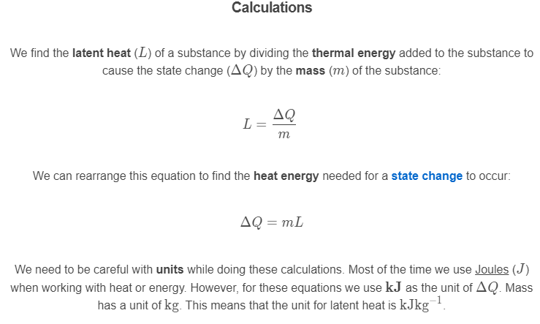

Slide 8

The latent heat of vaporisation is greater than the latent heat of fusion.
This is because when a substance evaporates all the bonds within the substance must be broken. However, when a substance melts the bonds are "stretched", which requires less energy input.

